Slide 1

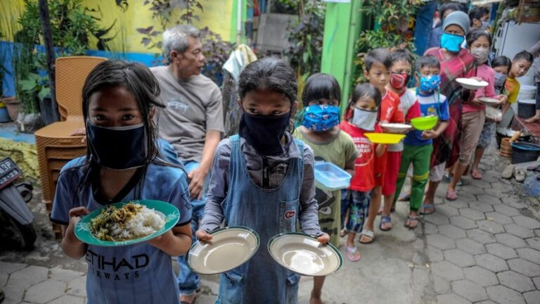
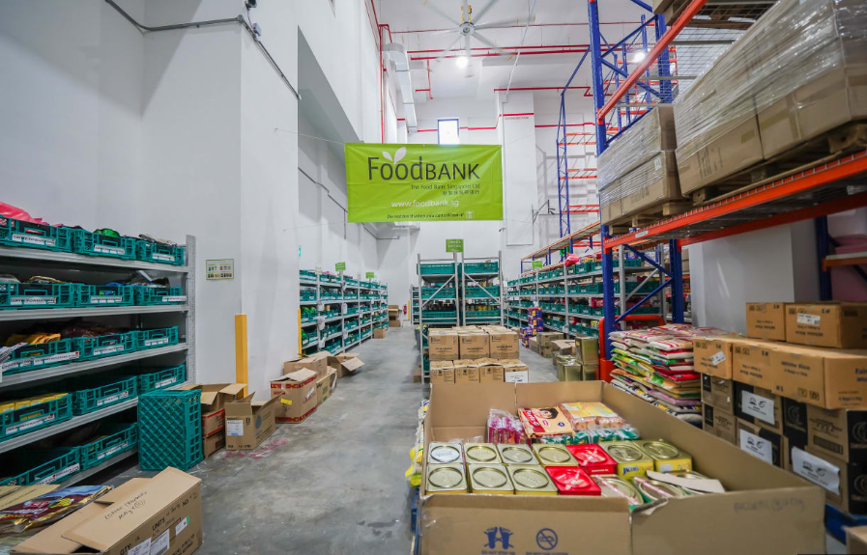
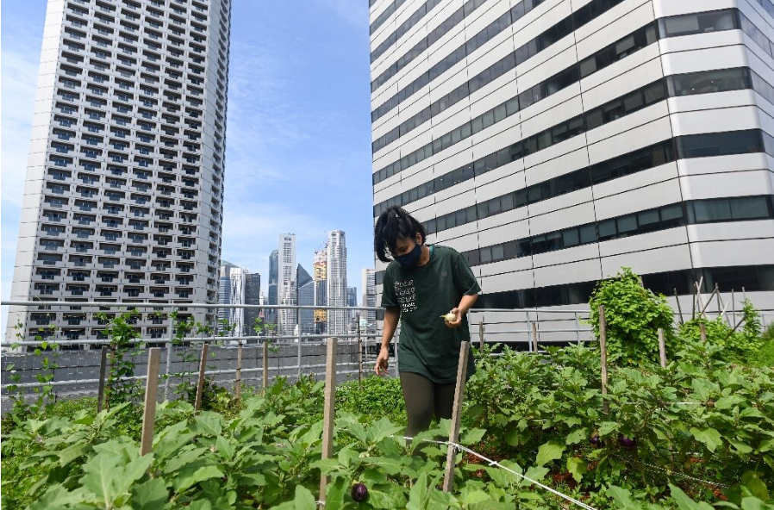
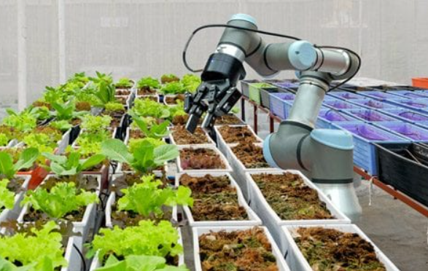
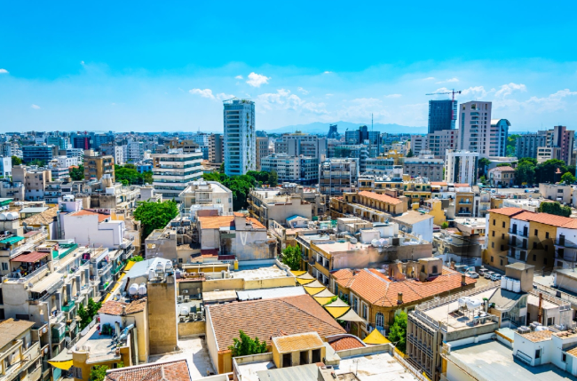
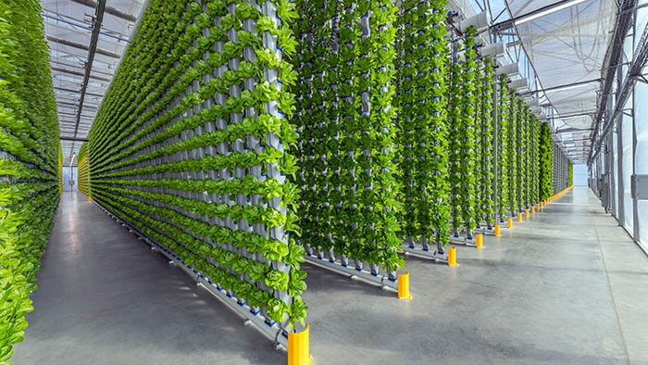
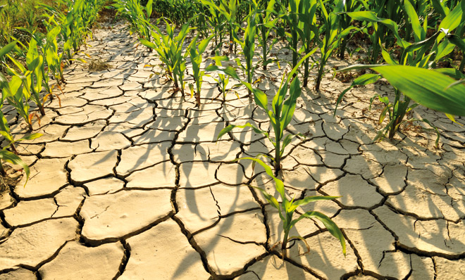
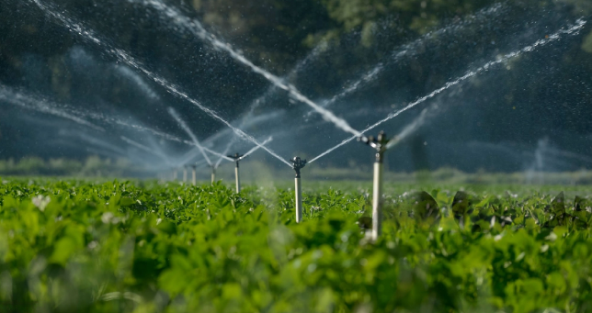
Singapore's Journey to Zero Hunger: A Story of Policy and Progress
The Sustainable Development Goals (SDGs) constitute a comprehensive framework designed to enact transformative change globally. They represent a collective commitment to eradicate poverty and inequity, safeguard the environment, and promote universal access to health, justice, and prosperity. Central to the SDGs is the principle of inclusivity, ensuring that no individual or group is marginalized or overlooked. Envisioned in 2015, the 2030 Agenda for Sustainable Development was unanimously adopted by all United Nations member states. This agenda delineates 17 overarching Goals accompanied by 169 specific targets. These Goals, characterized by their broad scope and ambitious aims, are interconnected, emphasizing the interdependence of various social, economic, and environmental issues.[1]
Benefits
Environmental Sustainability
Improves Quality of Life
Poverty Reduction
Global Collaboration
Problems
Implementation Challenges
Resource Constraints
Inequality
Global Cooperation
Fig 1.0 SDG Goals
SDG 2 in Singapore: A Closer Look at Zero Hunger Policies
In 1988, Singapore produced a modest fraction of its vegetables, supplemented by imports, while local farms focused on diverse crops including rapidly expanding mushroom cultivation, supported by specialized government research and guidance.[2] This necessitates innovative approaches to food security and sustainability.
Singapore actively engages with the principles of SDG 2 in its policies and implementation strategies by:
Food Security and Diversification: Diversifying food sources through initiatives like "30 by 30" for local production and supporting local agriculture and investing in high-tech farming methods.
Sustainable Agriculture and Innovation: Promoting sustainable practices through the Singapore Food Agency (SFA) and embracing innovative farming technologies and environmentally friendly practices.
Waste Reduction: Addressing food waste through regulatory measures and public awareness campaigns. collaborating with businesses to minimize waste along the supply chain.[3]
Fig 2.0 Image depicting hunger in Singapore
POLICIES
Food Security Act: Food security is achieved when individuals consistently have the means to obtain enough safe and nutritious food that aligns with their dietary requirements and preferences, ensuring their overall health and well-being remains sustained. [4]
30 x 30 Initiative: The "30 by 30" initiative demonstrates how innovation, technology, and ecological methods can transform urban environments into resilient food production centers, offering a beacon of hope for sustainability and food security. [5].
Fig 2.1 Food bank Singapore
Fig 2.2 Green rooftop: urban farming
Success Factors:
• Technological Innovation: Integration of smart farming and aquaponics.
• Collaboration with Private Sector: Partnerships with local businesses and food producers.
• Community Engagement: Involvement of citizens in sustainable practices.
Fig 2.3 Smart Farming
Challenges / Solutions
Land Scarcity: Urban expansion limits agricultural land, decreasing farming opportunities and exacerbating food shortages, emphasizing the impact of land scarcity.
Vertical Farming and Aggrotech: Vertical farming: Growing crops in stacked layers indoors to maximize space efficiency and yield.[6]
Fig 2.4 Urban Settlement
Fig 2.5 Vertical Farming
Climate Vulnerability: Severe climate conditions and increasing temperatures exert pressure on agricultural crops, impacting their growth and productivity.
Climate-Resilient Agriculture Boosting farm resilience: Implementing drought-tolerant crops and enhancing water efficiency practices to promote sustainable agriculture.[7]
Fig 2.6 Drought
Fig 2.7 Irrigation System
Conclusion
In conclusion, Singapore's policies on zero hunger showcase innovative approaches, yet challenges persist. Continued collaboration, technological advancements, and community engagement are imperative for achieving sustainable food security in Singapore.`

Slide 2
REFERENCES
[1]Sustainable Development Goals. (2024, January 18). https://www.who.int/europe/about-us/our-work/sustainable-development-goals#:~:text=The%20Sustainable%20Development%20Goals%20(SDGs,no%20one%20is%20left%20behind
[2] LePoer, B.L. and Vreeland, N. eds., 1991. Singapore: A country study. Washington, DC: Federal Research Division, Library of Congress. P110
[3] Grandhi, B. and Appaiah Singh, J., 2016. What a waste! A study of food wastage behavior in Singapore. Journal of Food Products Marketing, 22(4), pp.471-485.
[4]Key Points on Ensuring Food Security in Singapore. (n.d.). https://www.sg101.gov.sg/resources/current-topics/ensuringfoodsecurityinsingapore/
[5] Mok, W.K., Tan, Y.X. and Chen, W.N., 2020. Technology innovations for food security in Singapore: A case study of future food systems for an increasingly natural resource-scarce world. Trends in food science & technology, 102, pp.155-168.
[6] Dixon, J., & Aldridge, D. (2015). Vertical farming systems: A review of research trends and emerging technologies. Journal of Agricultural Science, 153(8), 1-18.
[7]World Bank. (2023). Climate-Smart Agriculture Investment Sourcebook. https://openknowledge.worldbank.org/handle/10986/38022: https://openknowledge.worldbank.org/handle/10986/38022
FIG 1.0 SDG Goals https://sdgwatcheurope.org/wp-content/uploads/2018/08/56e83cbc2e221-full-e1518533288468-573x500.jpeg
FIG 2.0 Hunger in Singapore https://assets.weforum.org/article/image/responsive_big_webp_iqYYt3r3cWhAyQbGAtCT7h6LBbZ-p8dXgCOrIkdLzvg.webp
FIG 2.1 Food bank https://give.asia/charity/the_food_bank_singapore
FIG 2.2 Green rooftop https://www.thesmartcityjournal.com/images/Imagenes-Articulos/2023_10_Octubre/urban_agriculture.jpg
FIG 2.3 Smart Farming https://www.agro-chemistry.com/news/e17-million-for-adaptive-autonomous-horticultural-growing-systems/robot-in-tuinbouwkas1/
FIG 2.4 Urban Settlement https://www.visitnicosia.com.cy/wp-content/uploads/2022/01/Picture2-1.jpg
FIG 2.5 Vertical Farming https://images.squarespace-cdn.com/content/v1/63064607eb816a4d50027fd1/ac17e0a8-e615-4f91-966e-c86354f5ee18/Borderlands_Eden-Green2.jpeg?format=1500w
FIG Drought 2.6 https://www.thoughtco.com/thmb/dySkDTKWmy0CQeWV5wSdUaoEIRQ=/750x0/filters:no_upscale():max_bytes(150000):strip_icc():format(webp)/GettyImages-182808134-56a9e2ea3df78cf772ab3a2c.jpg
FIG 2.7 Irrigation System https://www.europenowjournal.org/wp-content/uploads/2018/12/shutterstock_556950040-215x134.jpg

